Slide 1
POC oR GTFO
An intro to a Digital Preservation Pilot @ RPI

Slide 2
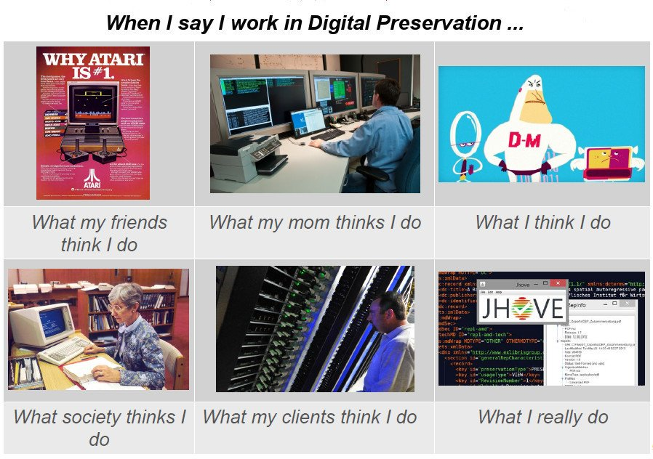
Credit: Mickey Lindlar

Slide 3
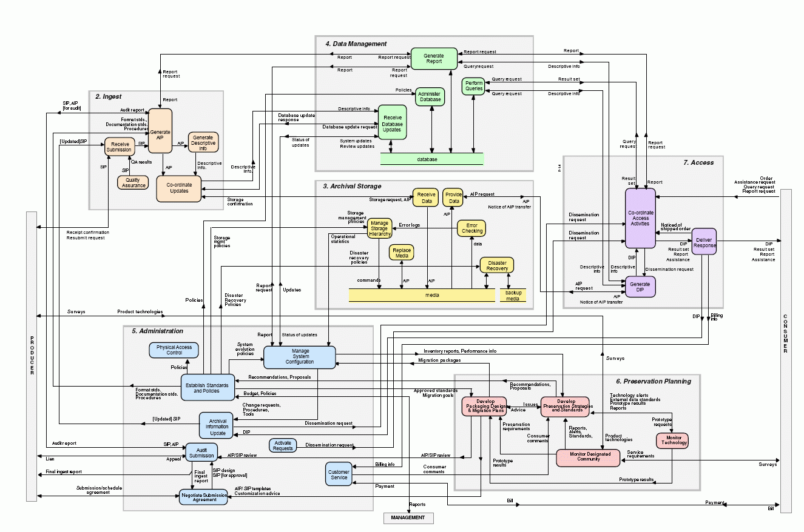

Slide 4
Digitization
≠
Preservation

Slide 5
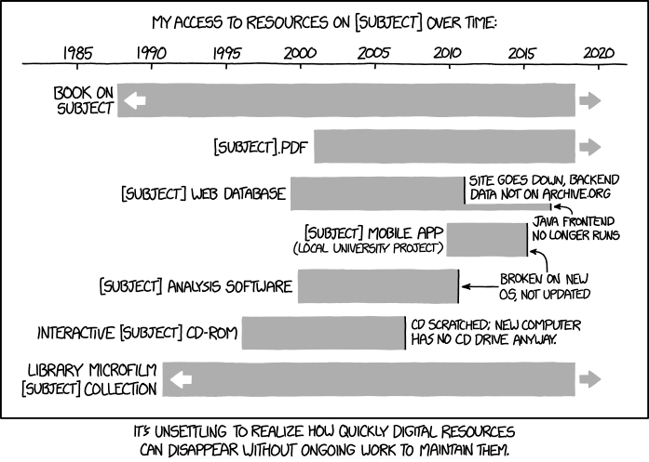

Slide 6
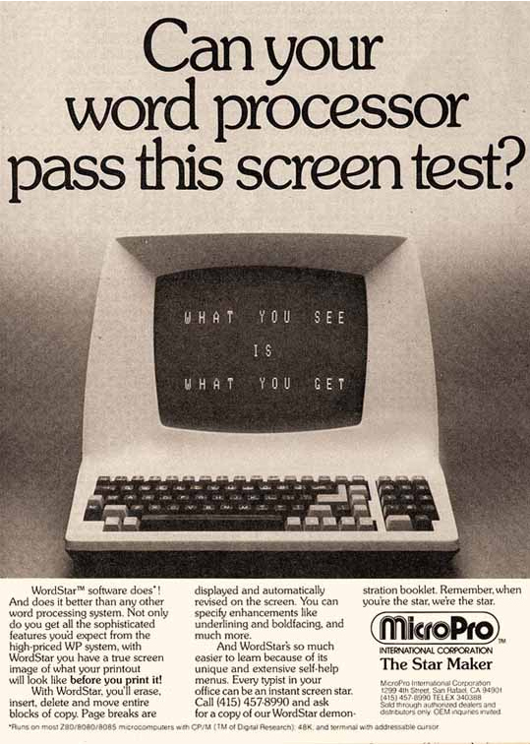
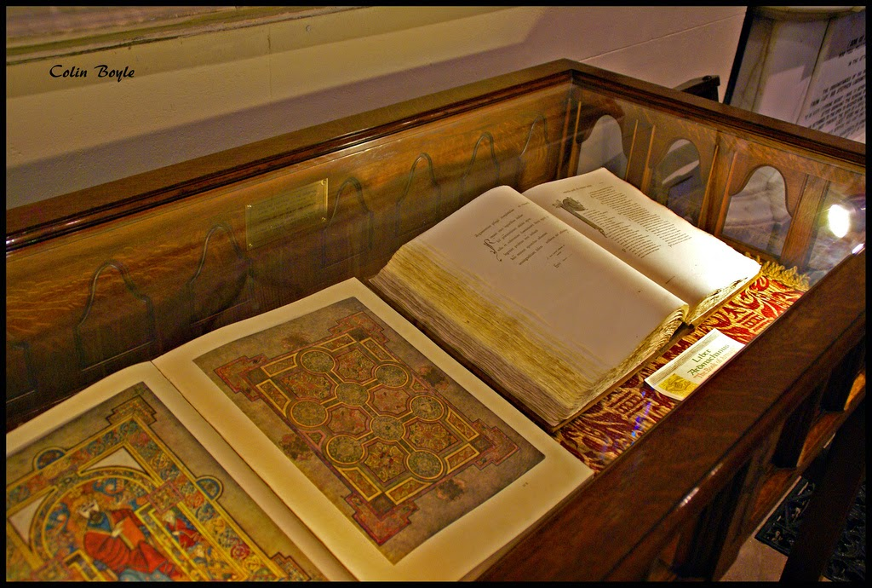
Book of Kells from 800 AD
WordStar from 1981

Slide 7
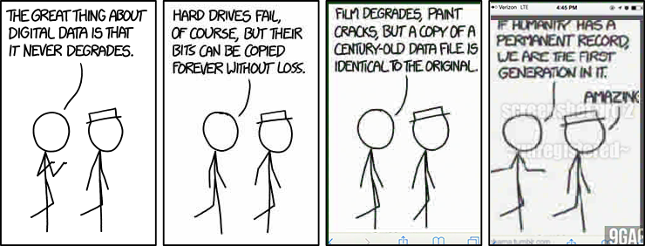

Slide 8
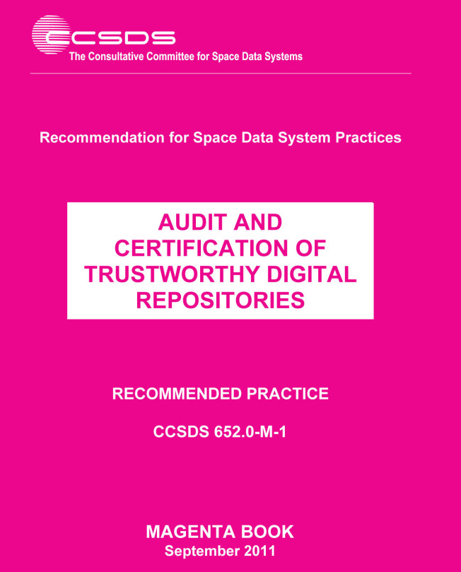

Slide 9
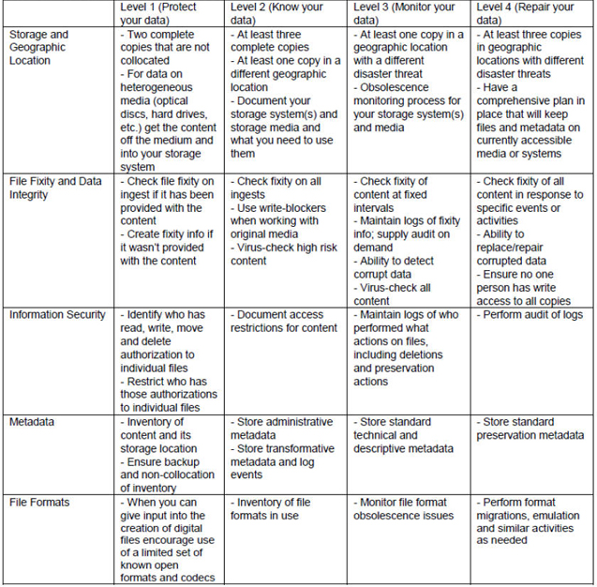
NDSA Levels of Digital Preservation:
http://ndsa.org/activities/levels-of-digital-preservation/

Slide 10
Five Organizational Stages
Acknowledge
Act
Consolidate
Institutionalize
Externalize
From The Five Organizational Stages of Digital Preservation, Anne R. Kenney and Nancy McGovern http://dx.doi.org/10.3998/spobooks.bbv9812.0001.001

Slide 11
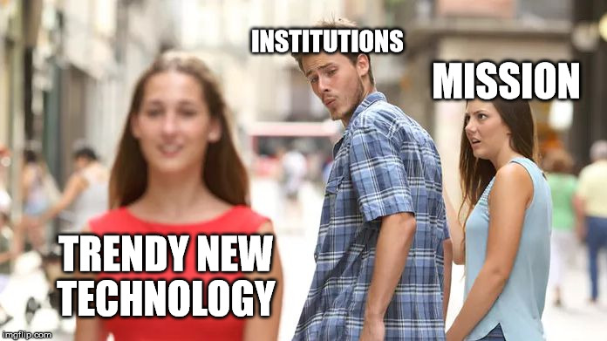
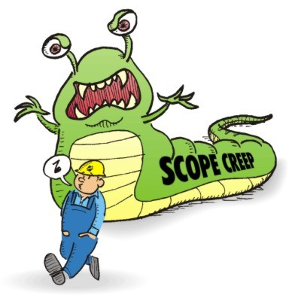
Step 1: What are We Doing & Why?

Slide 12
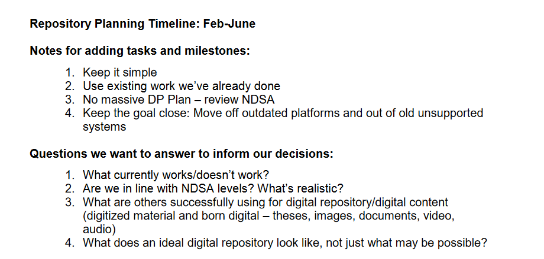
2. Also, How and WheN?

Slide 13
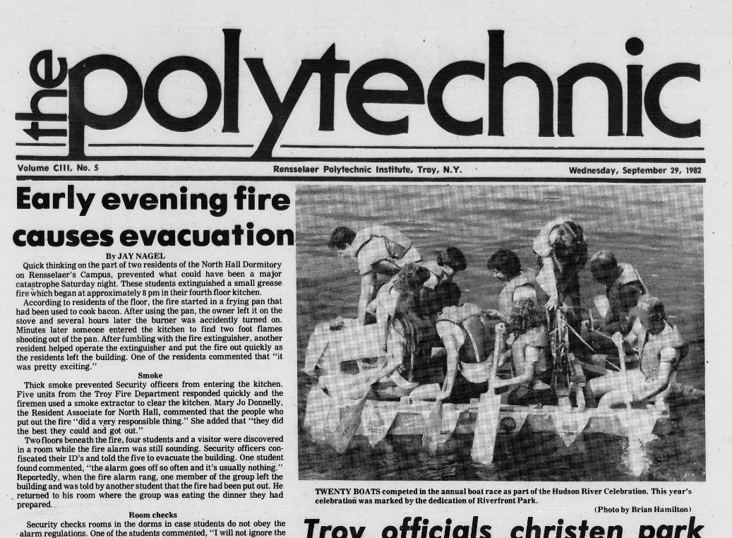
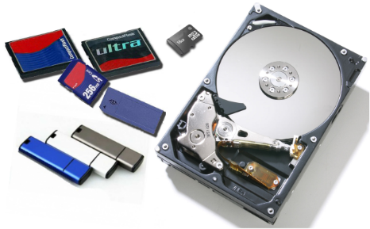

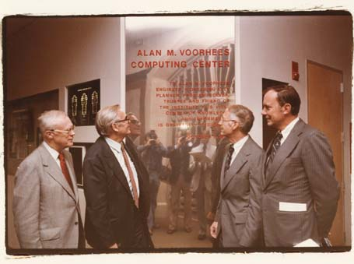


3. What do we have and what are we doing with it?

Slide 14
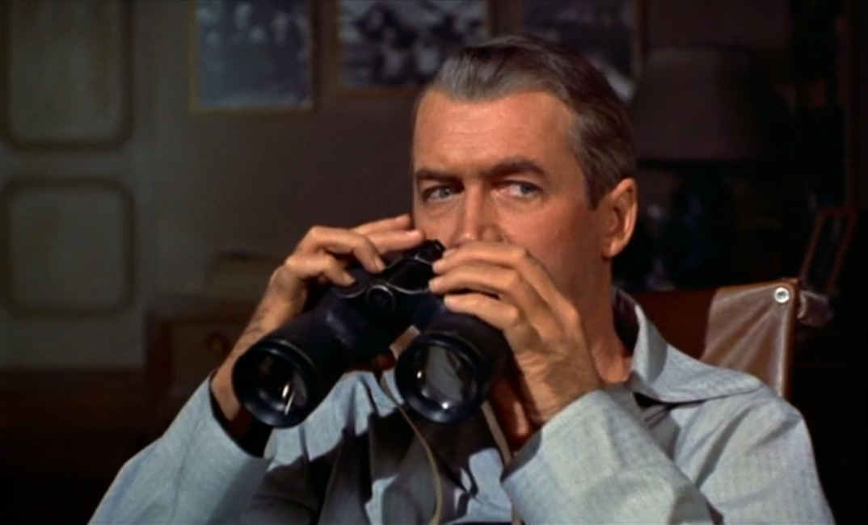
3. What do others have and what are they doing?

Slide 15

4. What do we want and need?

Slide 16
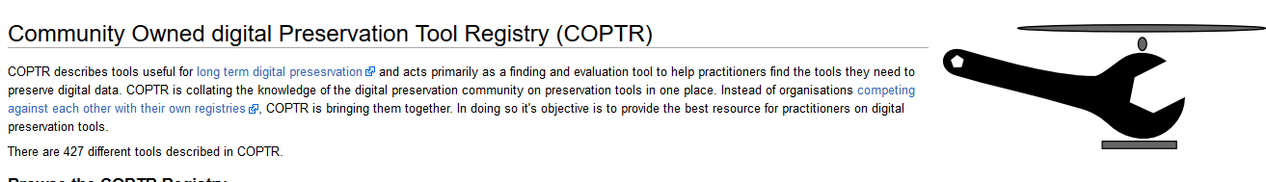
5. What’s out there that fits our needs?
AKA: Thanks, COPTR!
Ubergrid is here: http://www.digipres.org/tools/ubergrid/

Slide 17
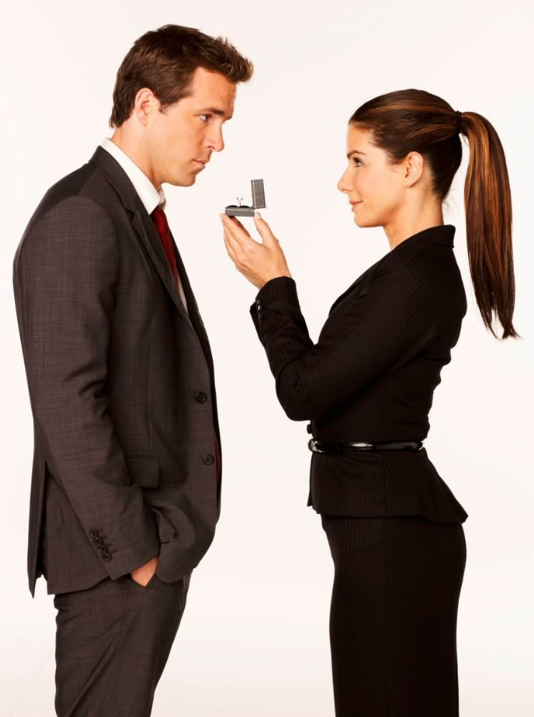
6. The Proposal

Slide 18
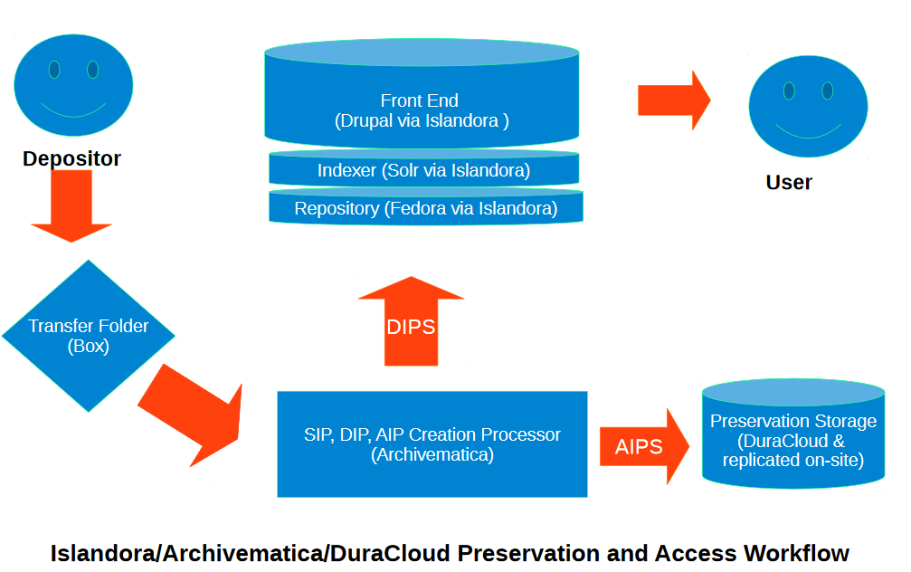

Slide 19

Isle Info sheet: https://drive.google.com/file/d/0B6CQnv3IL-CLcVlpcjItQWhDVmM/view
Isle github: https://github.com/Islandora-Collaboration-Group/ISLE
ICG github: https://github.com/Islandora-Collaboration-Group/icg_information

Slide 20
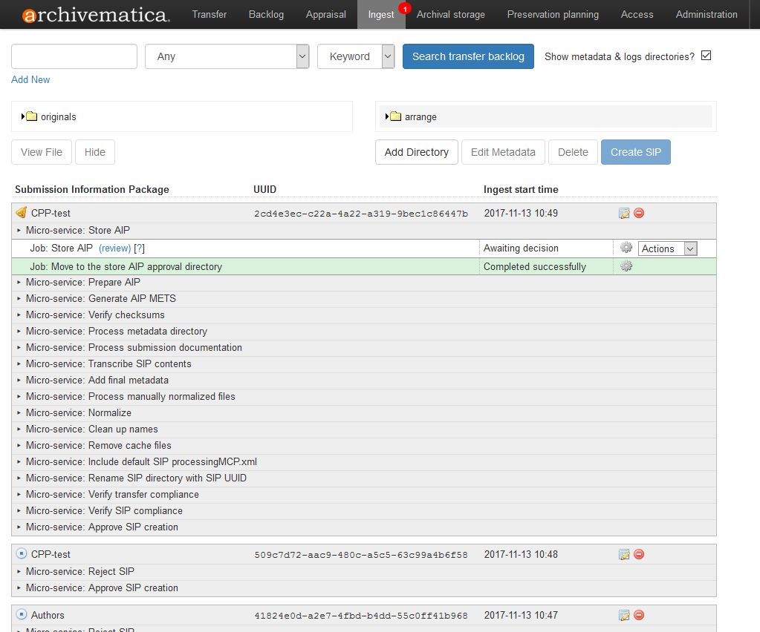
https://www.archivematica.org/en/

Slide 21
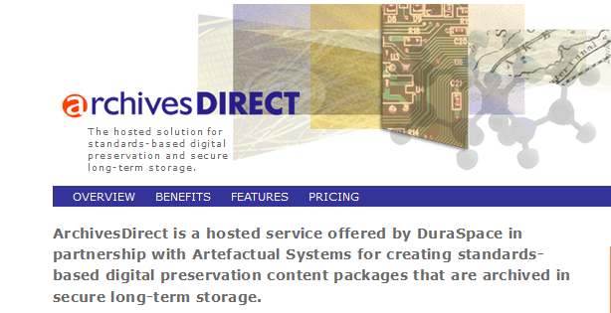
http://archivesdirect.org/

Slide 22

Phase two!
Testing POC & Policy Writing

Slide 23
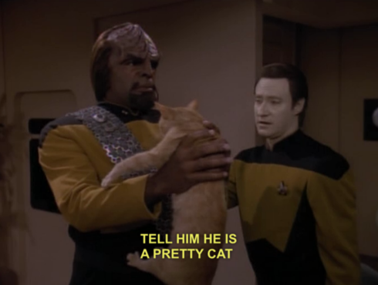
PHASE THREE!
Workflows/procedures/data models

Slide 24

What could go wrong?

Slide 25
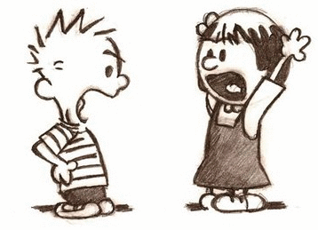
Let’s Discuss!

